Slide 1
Revenue and Ratings Trends by Genre
Prepared by: Bhavana, Lokesh, Nikhil

Slide 2
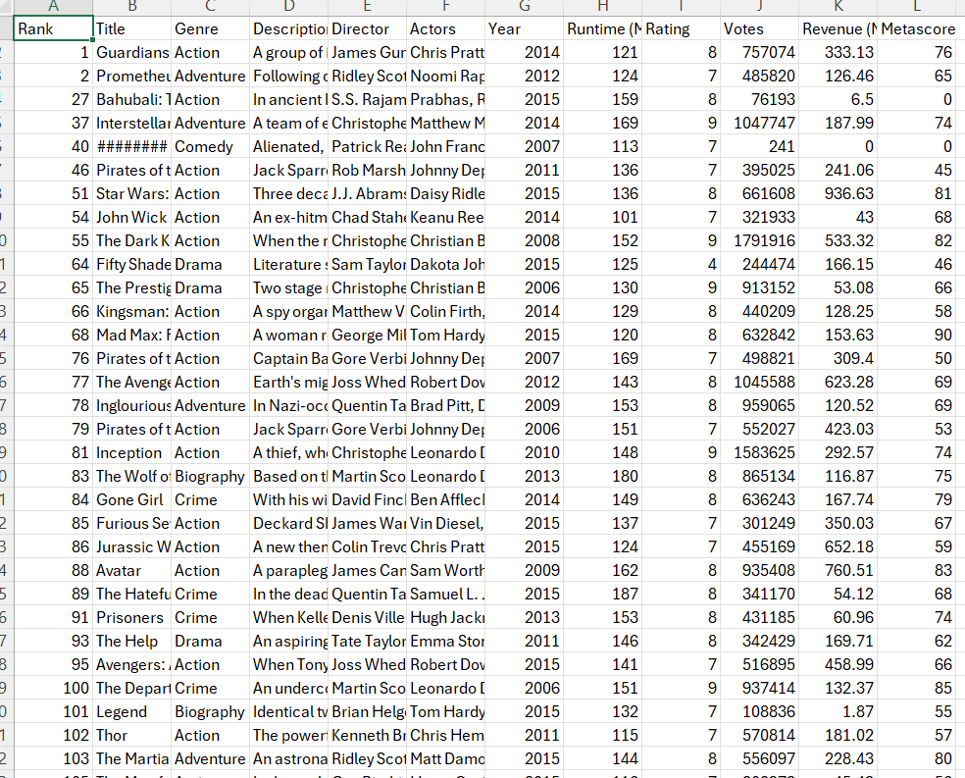
Dataset
Dataset : IMDB movie dataset
This visualization represents:
Revenue (in millions) by movie genre for the periods 2006 to 2015.
We have categorized the years into two groups: 2006–2010 and 2011–2015
Average Ratings on a scale of 1-10 for the same periods.

Slide 3
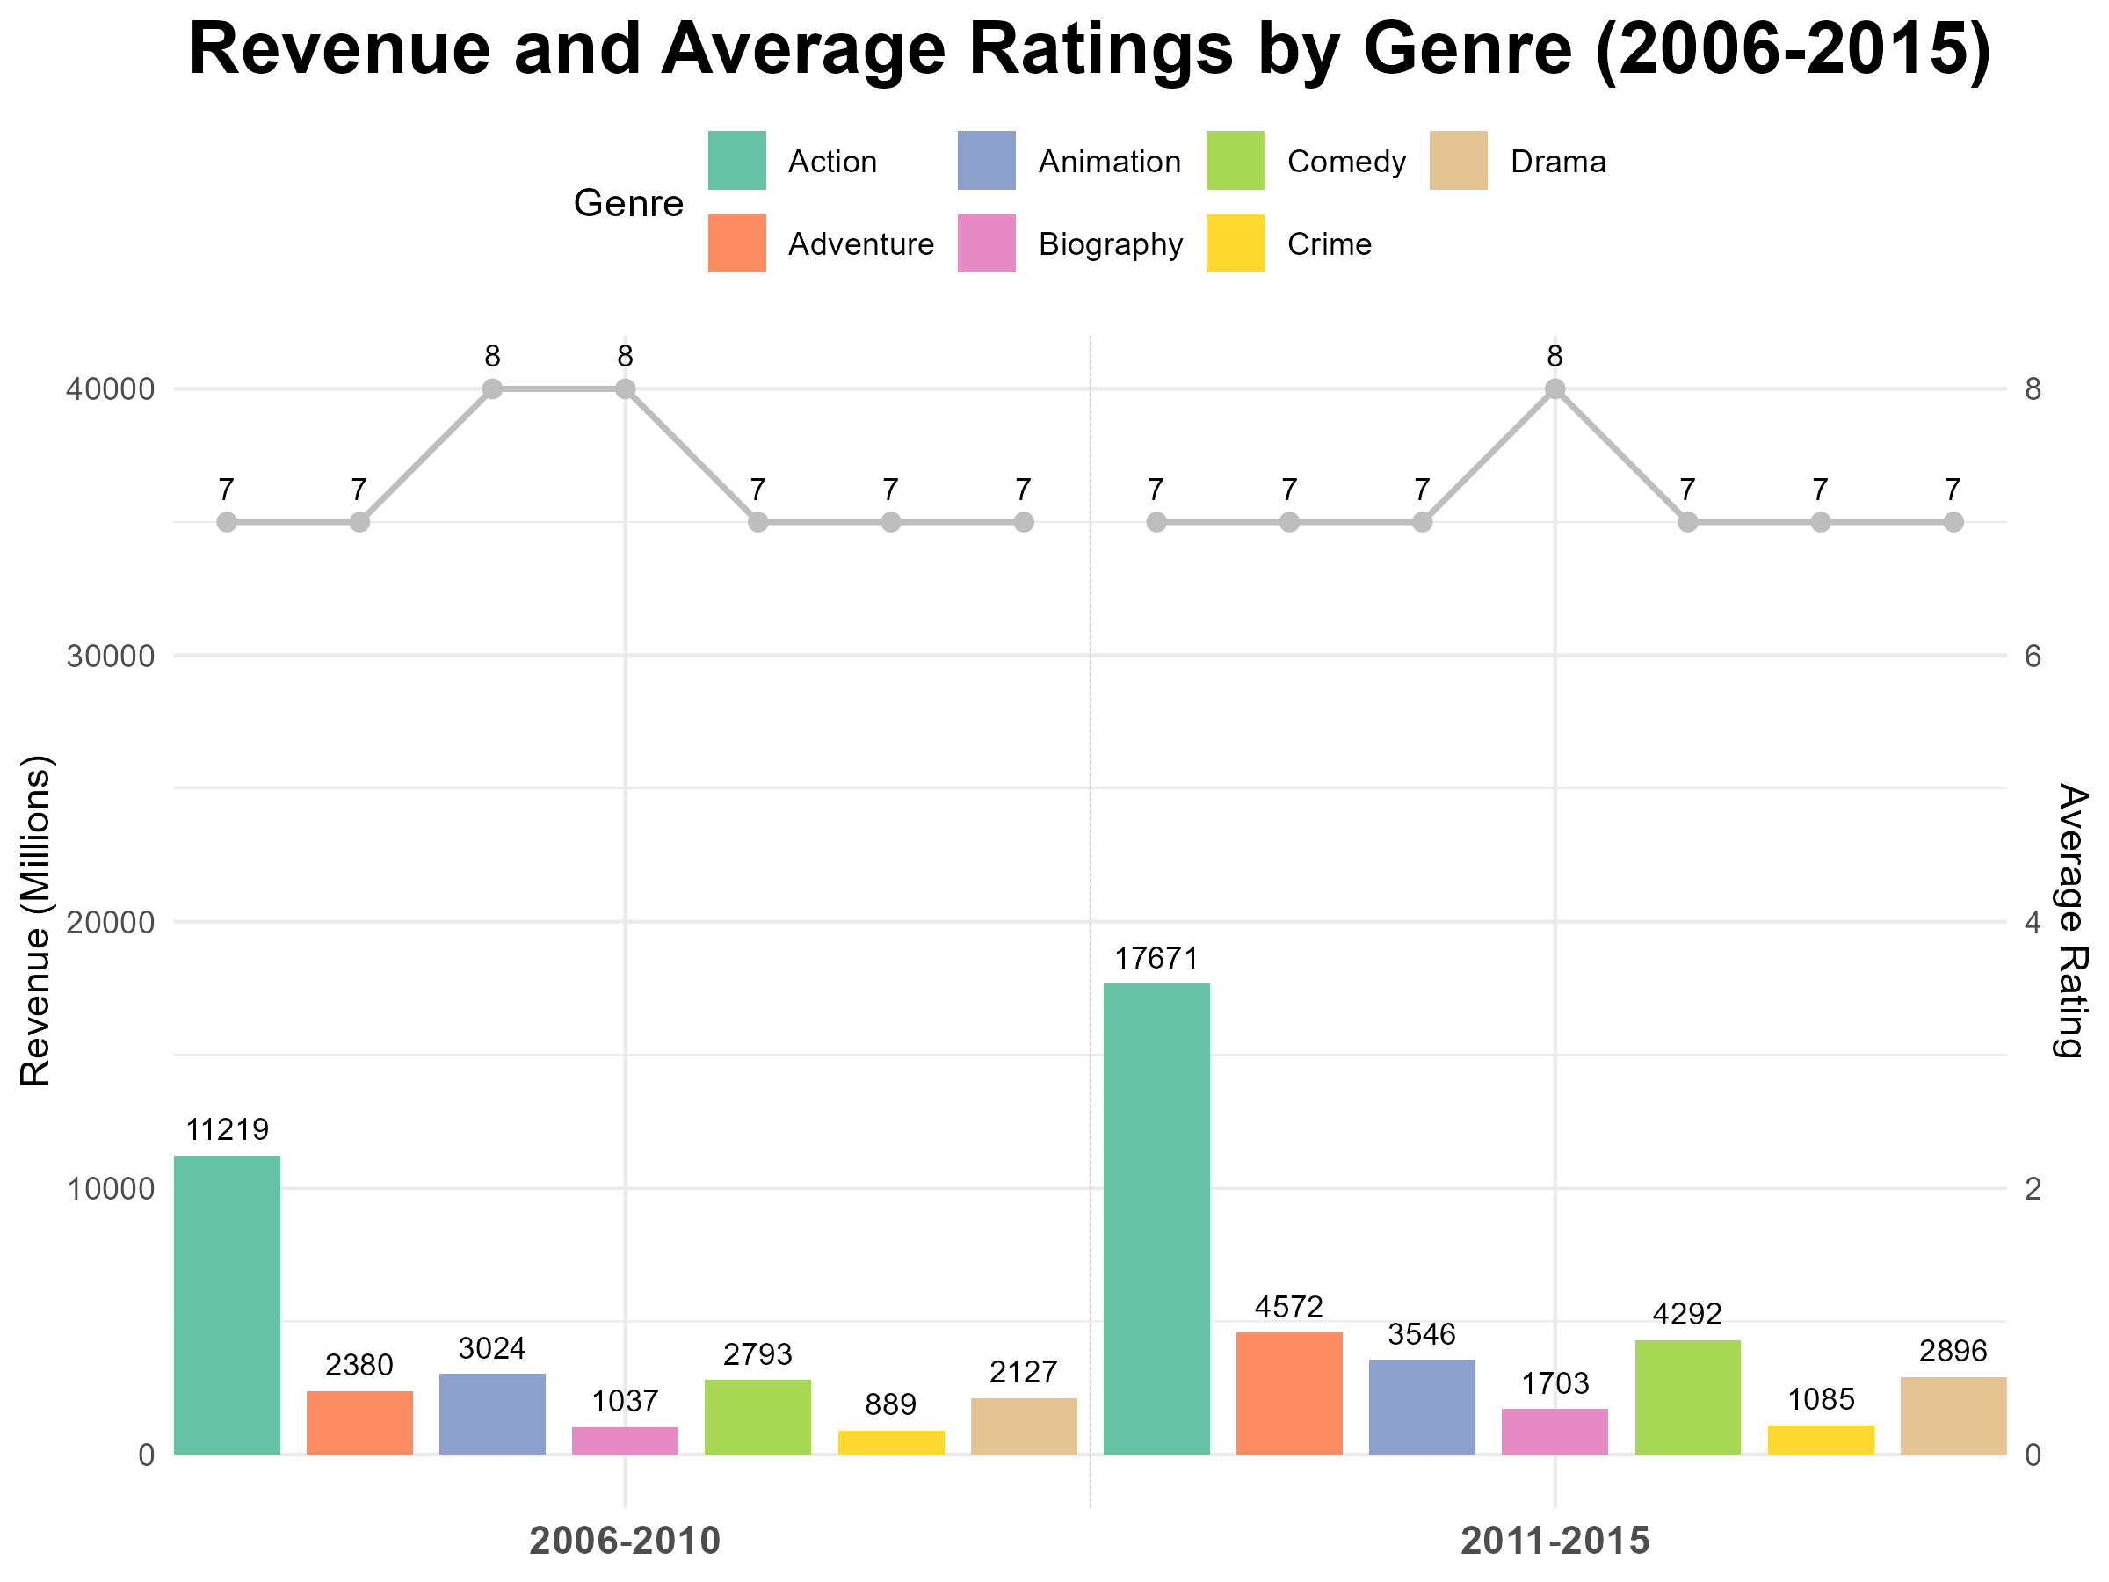
Visualization

Slide 4
Graph Explanation
The graph combines:
Bar chart: Revenue by genre
Line chart: Average ratings scaled to match revenue for comparison.
Key Elements:
X-axis: Genres separated by time period (2006-2010, 2011-2015).
Y-axis (left): Revenue in millions.
Y-axis (right): Average rating.
Legend: Movie Genres.

Slide 5
Data type and idiom
Data Types:
Categorical: Genre, Years
Quantitative: Revenue, Average Rating
Idiom
Bar graph
Line graph

Slide 6
Marks and Channels
Marks:
Bars ( Revenue)
Line Chart ( Ratings)
Text Annotation (Revenue and Ratings values are labeled for clarity)
Channels :
Region
Color
length

Slide 7
Relationships and task
Relationships:
Time vs. Revenue
Genre vs. Revenue
Genre vs. Rating
Time vs. Rating
Task :
Comparing

Slide 8
Insights and Analysis
Observations:
Revenue increased significantly for most genres between 2006-2010
and 2011-2015.
Average ratings remained relatively stable across genres.
Action and Comedy genres had the highest revenue growth.
Animation consistently received higher average ratings.

Slide 9
THANK YOU
☺

